Slide 1

STRATEGIES FOR E-CADHERIN RECYCLING: A COMPUTATIONAL MODEL
VAIBHAV AGARWAL
2020BB10061
BBD451 ENDSEMESTER PRESENTATION
Faculty mentor: AMIT DAS
Notes:
Good Evening respected panel members and fellow classmates. Today I have got the opportunity to present in front of you my BTP midterm presentation with the topic STRATEGIES FOR E-CADHERIN RECYCLING: A COMPUTATIONAL MODEL. In this presentation we would delve deep into what I had done till the midterms and discuss over it.

Slide 2
INDEX
INTRODUCTION | 3-4
MOTIVATION | 5
METHOD | 6-8
RESULT AND DISCUSSION | 9-11
SUMMARY AND CONCLUSION | 12
REFERENCES | 13

Slide 3
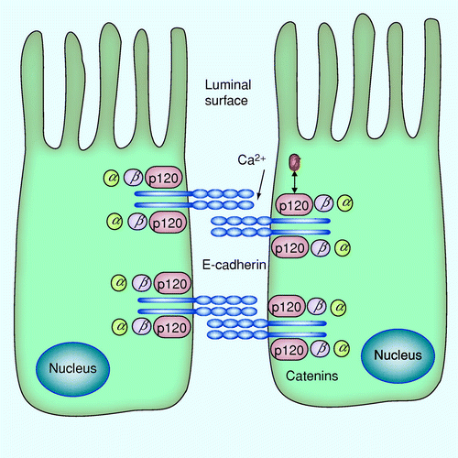
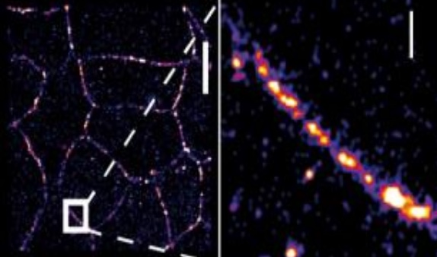
INTRODUCTION
Figure 1.1 A number of cytoplasmic proteins, including beta-catenin, alpha- catenin, and p120 catenin, engage with the intracellular domain of E-cadherin and establishes intracellular connection between two cells
Figure 1.2 Supramolecular organization of E-Cadherin. Higher magnification (bottom) shows uneven dense regions along a cell junction.
Communication Among Cells via Adhesion Molecules
Role of E-cadherin
E-cadherin and Proteins
Image source : Figure 1.1 Salon C, Lantuejoul S, Eymin B, Gazzeri S, Brambilla C, Brambilla E. The E-cadherin-beta-catenin complex and its implication in lung cancer progression and prognosis. Future Oncol. 2005 Oct;1(5):649-60. doi: 10.2217/14796694.1.5.649. PMID: 16556042. Figure 1.2 Binh-An Truong Quang.et.al– “Principles of E-Cadherin Supramolecular Organization In Vivo”, Current Biology 23, pg. 2197-2207(2013)
Notes:
So lets delve right into it, starting with E-cadherin, Some of it has already been explained by my fellow classmates like how it establishes connection between two cells, its role and the various proteins that it uses. so, Lets look at how it establishes connection between two cells. E-cadherin is a transmembrane protein with an extracellular domain that can bind to E-cadherin on adjacent cells. This homophilic interaction (E-cadherin binding to E-cadherin facilitated by various proteins like p120 catenin, alpha catenin, beta catenin inside the cell, their interaction with the actin cytoskeleton in the cell and amongst themselves have already been discussed) is the primary mechanism by which cells adhere to each other. As we can see in the figure the usage of Calcium ions are essential for the proper functioning of E-cadherin. The extracellular domain of E-cadherin has calcium-binding sites, and the binding of calcium is necessary for the rigidification and proper alignment of E-cadherin molecules. This enables effective homophilic interactions between E-cadherin molecules on adjacent cells. In the absence of calcium, E-cadherin cannot form stable interactions, leading to the disassembly of adherens junctions.

Slide 4
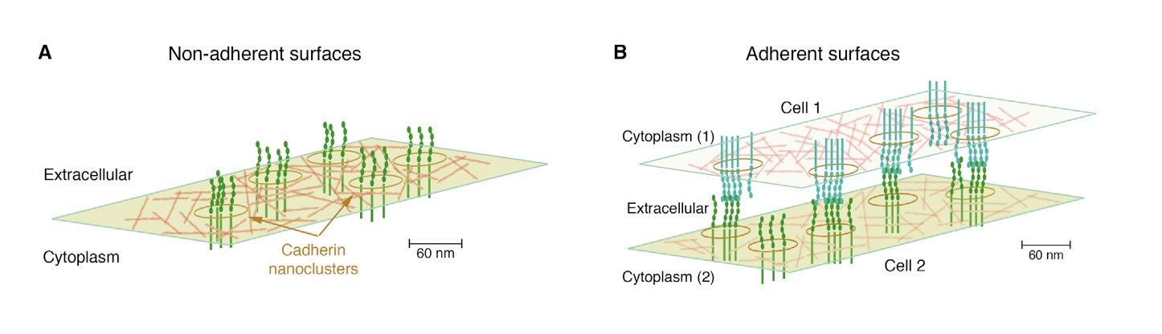
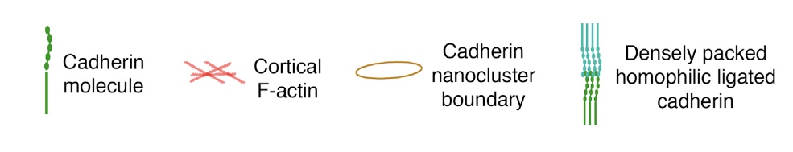
INTRODUCTION
Figure 1.3 E-Cadherin Clustering, showcasing Cell-Cell adhesion and Communication
Cortical F-actin drives lateral movement of E-Cadherin
E-Cadherin cis-interactions lead to nanoscale clusters
Cell-cell adhesion by E-Cadherin
trans-interactions
Image source : Figure 1.3 Yap AS, Gomez GA, Parton RG. Adherens Junctions Revisualized: Organizing Cadherins as Nanoassemblies. Dev Cell. 2015 Oct 12;35(1):12-20. doi: 10.1016/j.devcel.2015.09.012. PMID: 26460944.
Notes:
F-actin (Filamentous actin) is a polymer of the protein actin, and it forms part of the cytoskeleton in eukaryotic cells. The term "cortical" refers to the location of this F-actin, which is situated just beneath the cell membrane, forming a kind of meshwork. This cortical F-actin network is dynamic, meaning it can rapidly assemble and disassemble, allowing for changes in cell shape and movement. Here Lateral movement refers to the side-to-side mobility of E-cadherin molecules within the plane of the cell membrane. This mobility is essential for the dynamic remodeling of cell-cell junctions, which is crucial during processes like tissue development, wound healing, and even in some disease states like cancer and facilitated by this F-actin. When E-Cadherin molecules engage in cis-interactions (side-by-side intertactions), they tend to group together on the same cell surface, forming nanoscale clusters. These clusters are not just random gatherings but are highly organized structures that enhance the adhesive properties of cells. The clustering of E-Cadherin molecules can increase the stability and strength of cell-cell junctions, making tissues more robust, and also facilitate intracellular signaling
And as we already have discussed the trans-interactions (between two cells) leads to cell-cell adhesion

Slide 5
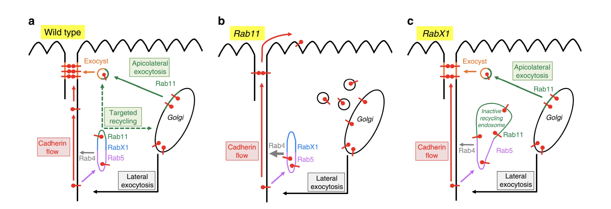
MOTIVATION
GOAL: To incorporate E-cadherin Recycling mechanism and explore its impact on the number of E-cadherin molecules on cell surface for various cell types
Recycling and its three ways
Why is understanding E-cadherin recycling important?
Cluster Formation and Endocytosis
Figure 2.1 Model depicting the three ways via which E-cadherin recycling takes place, Wild Type, Rab11 and RabX1
Image source : Figure 2.1 Woichansky I, Beretta CA, Berns N, Riechmann V. Three mechanisms control E-cadherin localization to the zonula adherens. Nat Commun. 2016 Mar 10;7:10834. doi: 10.1038/ncomms10834. PMID: 26960923; PMCID: PMC4792928.
Notes:
E-Cadherin recycling refers to the process by which E-Cadherin molecules are internalized from the cell surface and then either degraded or recycled back to the cell membrane. This recycling process is essential for maintaining the proper levels of E-Cadherin at the cell surface, which in turn is crucial for cell-cell adhesion and tissue integrity. The recycling of E-Cadherin is a highly regulated process and involves various proteins and pathways, including Rab proteins like Rab11 and RabX1. in the research paper they used drosophila or more commonly know as fruit fly because of the convenience and easier methodology by which the researchers viewed at different processes by which recycling took place
Wild Type: In a "wild type" or normal cell, E-Cadherin is internalized from the cell surface into endocytic vesicles. These vesicles then fuse with early endosomes. From the early endosomes, E-Cadherin can either be sent to late endosomes for degradation or recycled back to the cell surface. Wild-type cell shows a tubular structure (Rab5, RabX1 and Rab11) representing the early endosome and recycling endosome, where endocytosed DE-cad is sorted for recycling. DE-cad is also directly recycled by Rab4 (grey arrow)
Rab11: Rab11 is another Rab GTPase that is well-known for its role in regulating the recycling of transmembrane proteins like E-Cadherin. In Rab11 mutant cells all endocytosed DE-cad is directly recycled by Rab4. Apicolateral exocytosis is abolished and DE-cad vesicles accumulate within the cell. Absence of apicolateral exocytosis prevents ZA maintenance. The membrane flow is no longer restricted by the ZA and transports DE-cad into the apical PM domain.
RabX1: In RabX1 mutant cells endocytosed DE-cad accumulates in a large Rab5 and Rab11 compartment, which is unable to mediate recycling. The presence of Rab11 in this compartment might prevent that all endocytosed DE-cad is recycled by Rab4. The ZA is only partially affected as apicolateral exocytosis and membrane flow are functional.
Understanding the mechanisms of E-Cadherin recycling is crucial for various biological processes and medical applications. For instance, disruptions in E-Cadherin recycling can lead to weakened cell-cell adhesion, which is a hallmark of various diseases, including cancer. In cancer, the loss of E-Cadherin function can facilitate tumor invasion and metastasis.
Cluster formation and endocytosis are often interconnected. When receptor proteins cluster together on the cell surface, they may be internalized through endocytosis for degradation or recycling. This can serve as a mechanism to terminate signaling pathways or to recycle receptors back to the cell surface for further use. In some cases, the clustering of specific proteins can serve as a signal for the cell to initiate endocytosis.

Slide 6
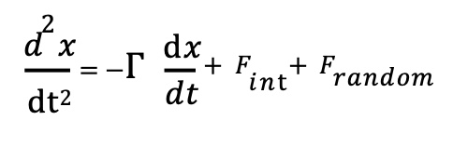
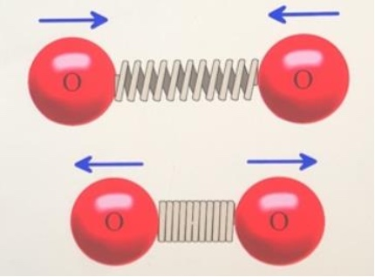
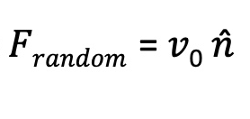

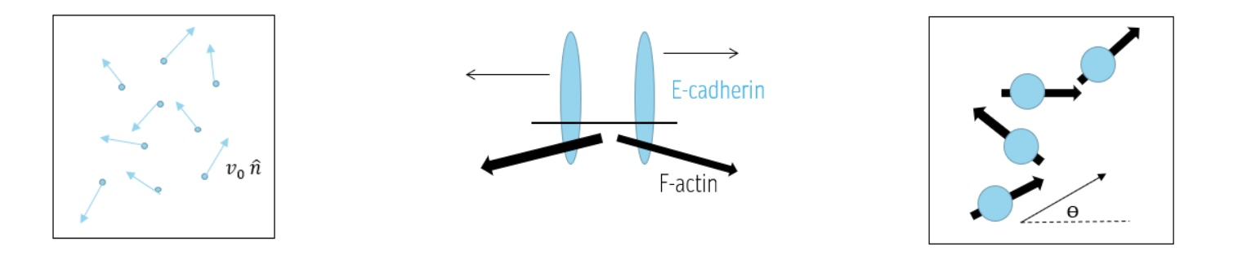
METHOD
The Langevin Equation: A Tool we used for Regulating Protein Molecule Motion
---------------------------- (1)
Here, Γ is the friction coefficient, 𝑑x ⁄𝑑𝑡 indicates the velocity of the particle,
𝐹_{int} denotes the force of interaction between particles, and 𝐹_{random} represents
the force arising from the unpredictable motion due to cortical F-actin and surrounding fluid.
------------------(2) --------------------(3)
Here, 𝑣0 is the is the characteristic velocity of the protein molecules arising from F-actin, And n̂ is a unit vector that points in a random direction at any instant
Fig 3.1 Force Interaction between two protein molecules via a spring model
Fig 3.2 Random movement of E-cadherin molecules
Fig 3.3 Active movement of E-cadherin molecule by F-actin
Fig 3.4 Top-view of the cell membrane showing active movement of E-cad
Image source : ​
Figure 3.1: https://chemistry.stackexchange.com/questions/41889/if-chemical-bonding-is-quantum-mechanic-is-saying-they-bend-and-vibrate-like-sp
Figure 3.2, 3.3, 3.4: Ms. Radhika Bagmare BTP Midterm Presentation for BBD451, 2019 Batch of Biotechnology and Biochemical Engineering. https://drive.google.com/file/d/1b7IQLM_ika2IYwX1OeeyE2Qk8dLdWPyU/view?usp=sharing
Notes:
Coming to methods, lets discuss how we created a computational model that could simulate protein molecules on cell surface and active interaction between them. Some of it has already been Discussed by Arsh on how these molecules act based on their interaction and forces present. Frandom depicts the forces due to unpredictable motion or surrounding fluid or environment, Fint depicts the force due to interaction of the particles which is harmonic in nature as shown by the spring attached to two balls graphic and other relevant forces. Using these forces and the Langevin Equation for random motions Ms Radhika created a computational model that governed the protein molecules dynamics and subsequent clustering based on these forces.

Slide 7
METHOD
To tackle the recycling mechanism we considered all the three
Recycling methods for E-cadherin to be in a Black Box. This helped us
Get the molecules in and out of the mechanism to be added back onto the
Cell surface in a relatively easier manner.
n_{d} removed molecules at t=100
Recycling Mechanism
n_{a} added molecules at t=100
recycledParticles added back at t=100+30
n_{d} removed molecules
recycledParticles
Fig 3.6 Graphic showing E-cadherin Recycling, Exocytosis
and Endocytosis in a Nutshell
Degradation
Fig 3.5 Recycling Mechanism for E-cad in a cell simplified
Notes:
But there was no consideration of recycling of the molecules that are being endocytosed back into the cell, which as we have discussed is a major and important process in the e-cadherin clustering and cellular maintenance. So initially for the first part of this project we are considering all these recycling methodologies to be present in a virtual black box, which in turn just takes in the molecules for recycling and returns them back to be added back onto the cell surface as shown in figure 3.5 and figure 3.6, this methodology works best because it would help us see whether or not incorporating this into the previous model gives us other results or not. Which it shouldn’t. now to take care of the fact that if we keep on adding more and more molecules back and keep the exocytosis rate constant we would simply see accumulation of e-cadherin molecules on the cell surface, to eliminate this we reduce the number of na, the added molecules by the recycled_particles, which depends upon the removed molecules nd and the recycleRate, which shows the fraction of the endocytosised molecules that are going to be recycled and added back at a later stage given by recycleFreq which is 30 in Fig 3.6. The rest of the molecules that weren’t able to be recycled are sent for degradation.

Slide 8
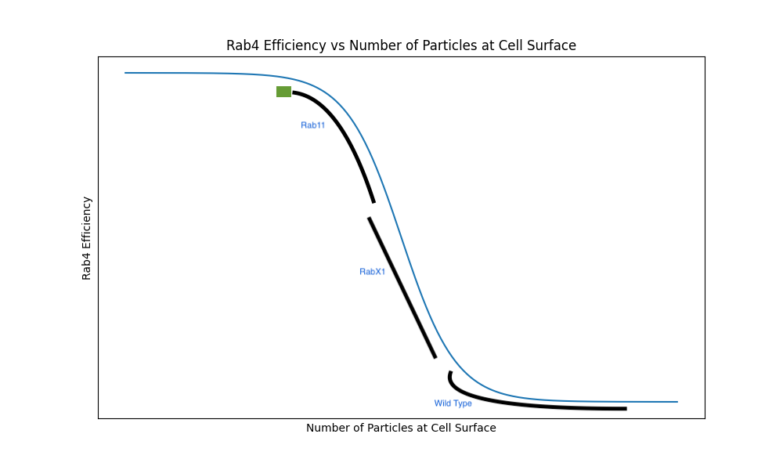
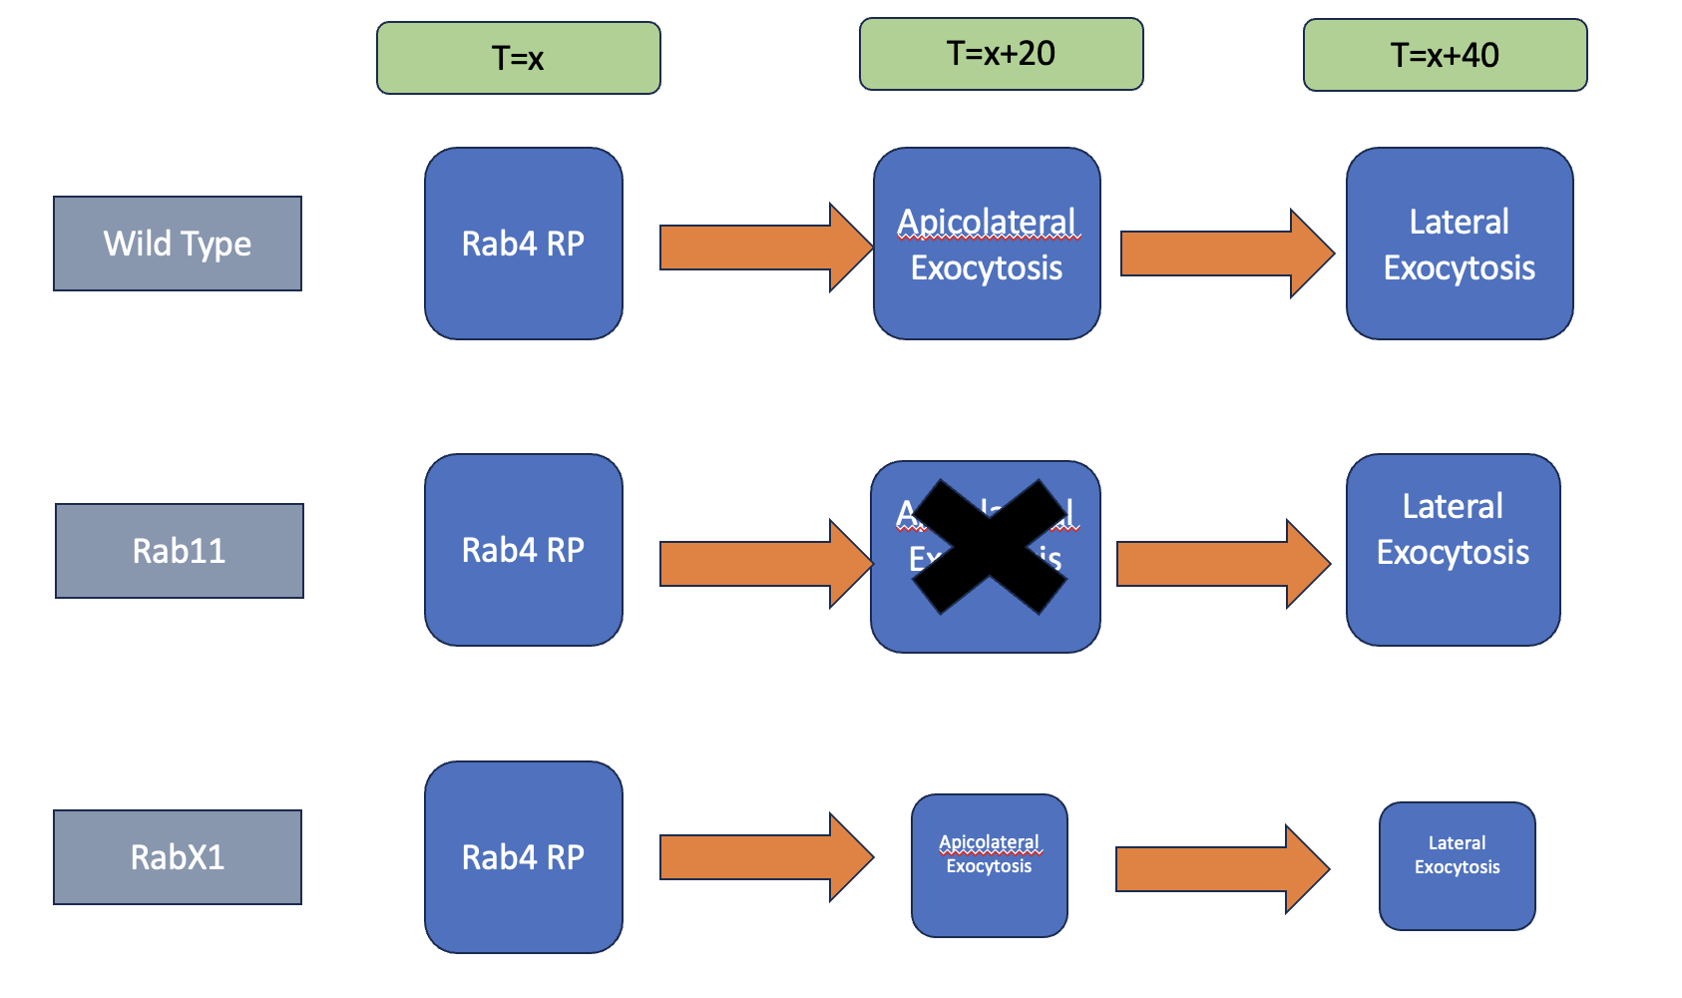
METHOD
Fig 3.7: Graphic Depicting Difference between the cell
types for E-cad molecule exocytosis
Fig 3.8: Depicting Rab4 efficiency as a Hill Function for accurate measurements
Notes:
But there was no consideration of recycling of the molecules that are being endocytosed back into the cell, which as we have discussed is a major and important process in the e-cadherin clustering and cellular maintenance. So initially for the first part of this project we are considering all these recycling methodologies to be present in a virtual black box, which in turn just takes in the molecules for recycling and returns them back to be added back onto the cell surface as shown in figure 3.5 and figure 3.6, this methodology works best because it would help us see whether or not incorporating this into the previous model gives us other results or not. Which it shouldn’t. now to take care of the fact that if we keep on adding more and more molecules back and keep the exocytosis rate constant we would simply see accumulation of e-cadherin molecules on the cell surface, to eliminate this we reduce the number of na, the added molecules by the recycled_particles, which depends upon the removed molecules nd and the recycleRate, which shows the fraction of the endocytosised molecules that are going to be recycled and added back at a later stage given by recycleFreq which is 30 in Fig 3.6. The rest of the molecules that weren’t able to be recycled are sent for degradation.

Slide 9
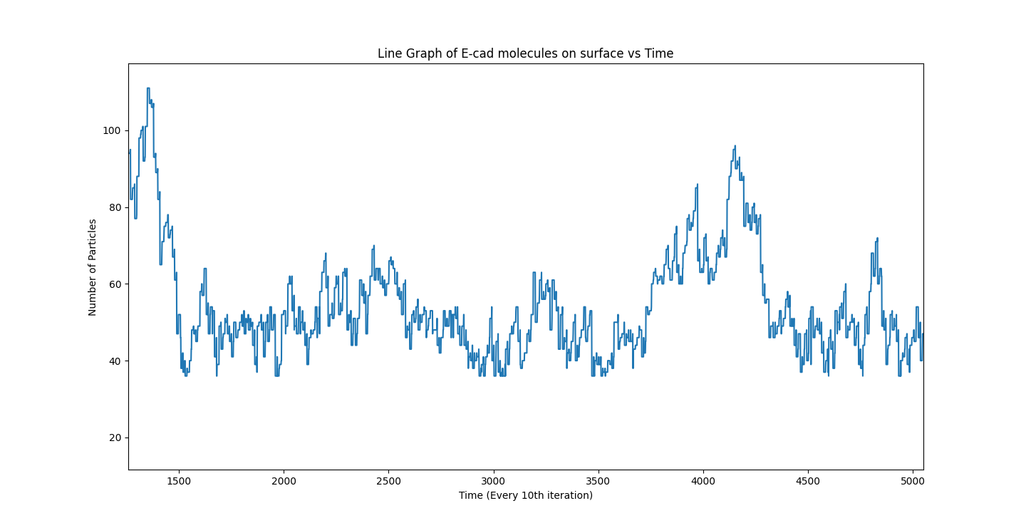
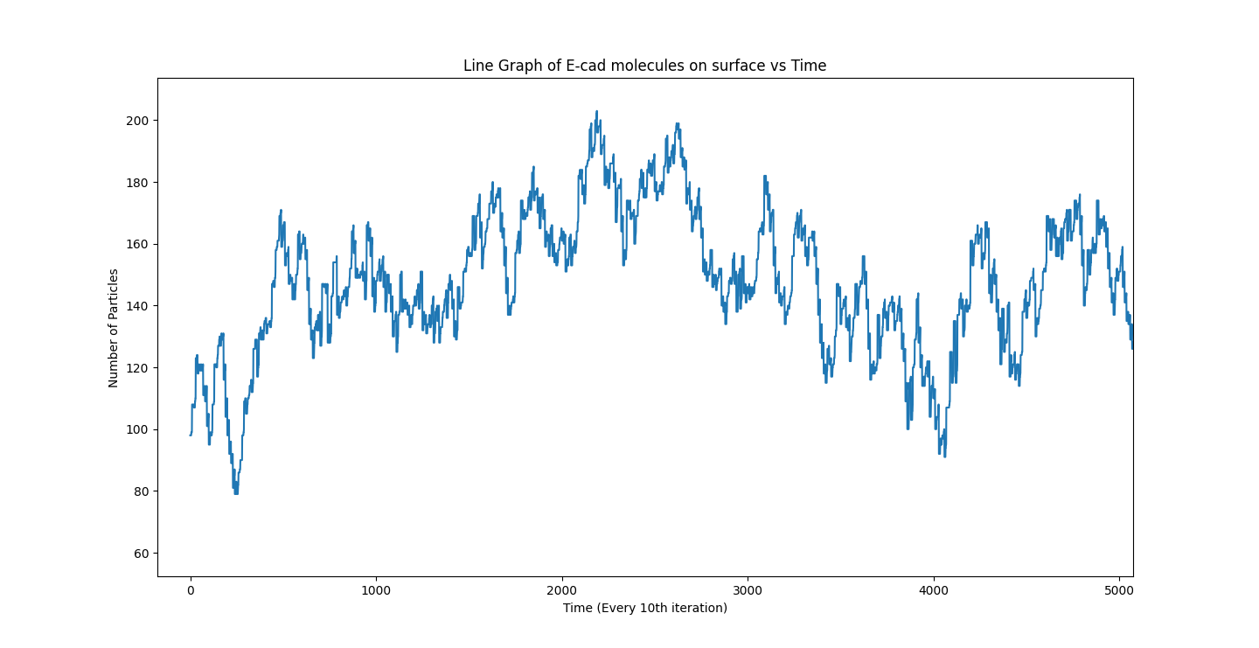
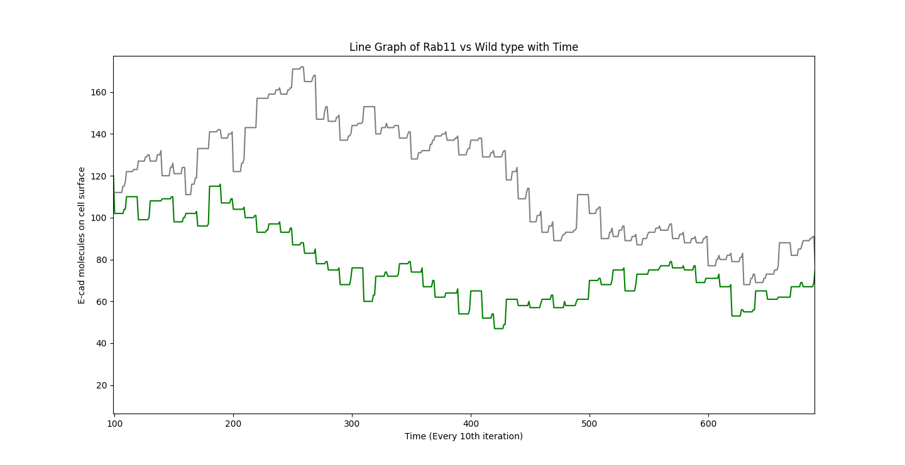
RESULTS AND DISCUSSION
Rab11 vs Wild Type
Fig4.1 Depicting E cad molecules on cell surface of Mutant Rab11
Fig 4.2 Depicting E cad molecules on cell surface of Wild Type
Fig4.3 Depicting E cad molecules on cell surface of Mutant Rab11
Notes:
Let us now look at the results with the incorporated changes, as we can see in the above three cases shown, in each we have different exocytosis and endocytosis rate. Looking at Fig 4.1 where the endocytosis rate is equal to exocytosis we see similar movement and clustering of protein molecules for 10000 iterations of protein movement, which is the desired result. Now in the case when endocytosis rate is lesser than exocytosis rate we see an increase in number of protein molecules for both the cases as expected, due to more molecules being added back and in the final case when endocytosis rate is higher than exocytosis rate we start with 200 molecules to better grasp the reduction in protein molecules and as we can see the number of molecules reduce as time goes on for both the cases

Slide 10
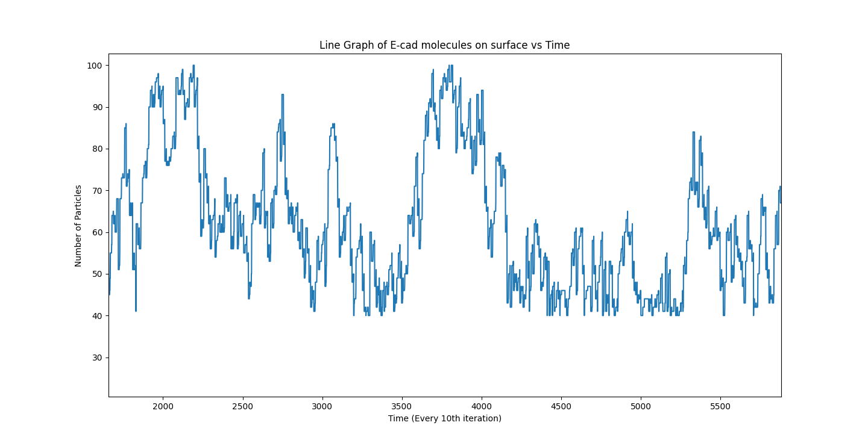
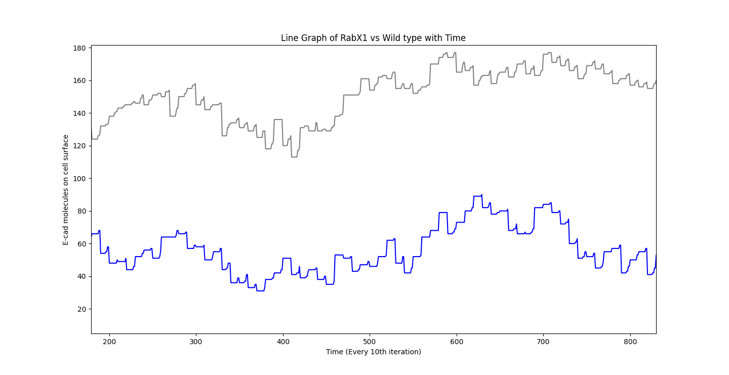
RESULTS AND DISCUSSION
RabX1 vs Wild Type
Fig 4.4 Depicting E cad molecules on cell surface of Mutant RabX1
Fig 4.5 Depicting E cad molecules on cell surface of Wild Type
Fig 4.6 Depicting E cad molecules on cell surface of Mutant RabX1
Notes:
Let us now look at the results with the incorporated changes, as we can see in the above three cases shown, in each we have different exocytosis and endocytosis rate. Looking at Fig 4.1 where the endocytosis rate is equal to exocytosis we see similar movement and clustering of protein molecules for 10000 iterations of protein movement, which is the desired result. Now in the case when endocytosis rate is lesser than exocytosis rate we see an increase in number of protein molecules for both the cases as expected, due to more molecules being added back and in the final case when endocytosis rate is higher than exocytosis rate we start with 200 molecules to better grasp the reduction in protein molecules and as we can see the number of molecules reduce as time goes on for both the cases

Slide 11
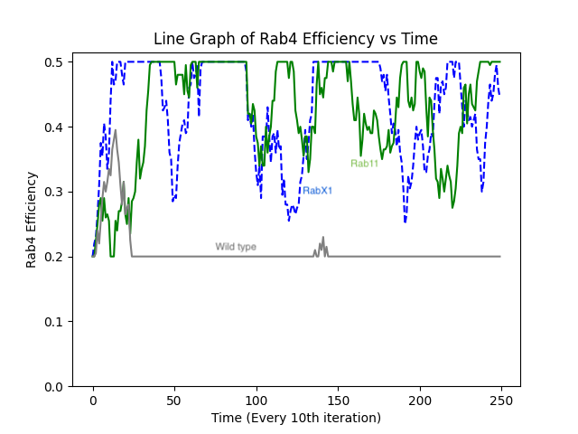
RESULTS AND DISCUSSION
Fig: 4.7 Rab4 efficiency comparisons between all three cell types. Grey line being
the Wild type, Blue line being the RabX1 and green being the Rab11
Notes:
Let us now look at the results with the incorporated changes, as we can see in the above three cases shown, in each we have different exocytosis and endocytosis rate. Looking at Fig 4.1 where the endocytosis rate is equal to exocytosis we see similar movement and clustering of protein molecules for 10000 iterations of protein movement, which is the desired result. Now in the case when endocytosis rate is lesser than exocytosis rate we see an increase in number of protein molecules for both the cases as expected, due to more molecules being added back and in the final case when endocytosis rate is higher than exocytosis rate we start with 200 molecules to better grasp the reduction in protein molecules and as we can see the number of molecules reduce as time goes on for both the cases

Slide 12
SUMMARY AND CONCLUSION
Breaking down the recycling processes
Interplay between the recycling processes
Dynamic Model that interacts with itself
Efficiency of Rab4 protein and shut down of Apicolateral Exocytosis when Rab11 protein is not present
Final Model representing E Cadherin molecules on cellular surface of three cell types which dynamically changes based on cell type
Recycling process done via three mediums, Apicolateral, Lateral and Direct (Rab4) exocytosis
Notes:
For the future plan for this project, we would want to incorporate more of the three discussed recycling processes as individual units and not in a black box, depending upon the various factors discussed during e-cadherin recycling we can develop a model in which the three recycling processes occur on the basis of the current molecules present, whether that particular process was used last time , how fast we need the molecules on the cell surface and a number of other factors. Establishing a interplay between these recycling processes and finally creating a dynamic model showcasing the cluster formation of e-cadherin molecules with recycling

Slide 13
REFERENCES
Salon C, Lantuejoul S, Eymin B, Gazzeri S, Brambilla C, Brambilla E. The E-cadherin-beta-catenin complex and its implication in lung cancer progression and prognosis. Future Oncol. 2005 Oct;1(5):649-60. doi: 10.2217/14796694.1.5.649. PMID: 16556042.
Binh-An Truong Quang.et.al– “Principles of E-Cadherin Supramolecular Organization In Vivo”, Current Biology 23, pg. 2197-2207(2013)
Yap AS, Gomez GA, Parton RG. Adherens Junctions Revisualized: Organizing Cadherins as Nanoassemblies. Dev Cell. 2015 Oct 12;35(1):12-20. doi: 10.1016/j.devcel.2015.09.012. PMID: 26460944.
Woichansky I, Beretta CA, Berns N, Riechmann V. Three mechanisms control E-cadherin localization to the zonula adherens. Nat Commun. 2016 Mar 10;7:10834. doi: 10.1038/ncomms10834. PMID: 26960923; PMCID: PMC4792928.
Radhikha Bagmare Endterm Report for BBD451, Batch of 2019 Biotechnology and Biochemical Engineering https://drive.google.com/file/d/1e7- eAMUzLDibqPVemeewOvpuhIl3IuFm/view?usp=sharing
Notes:
Lastly I would like to thank to all these sources and research papers that helped me better understand this project, alongwith Radhika’s work which was a great starting point and Professor amit das for being my faculty mentor and guiding me throughout the whole project

Slide 14
THANK YOU!
Any Questions?

